Slide 1
The Library Learning Commons:
The Transition to Student-Centered Spaces for Discovery, Creation, and Sharing

Slide 2
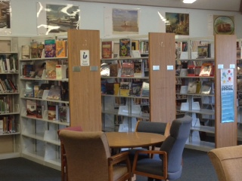
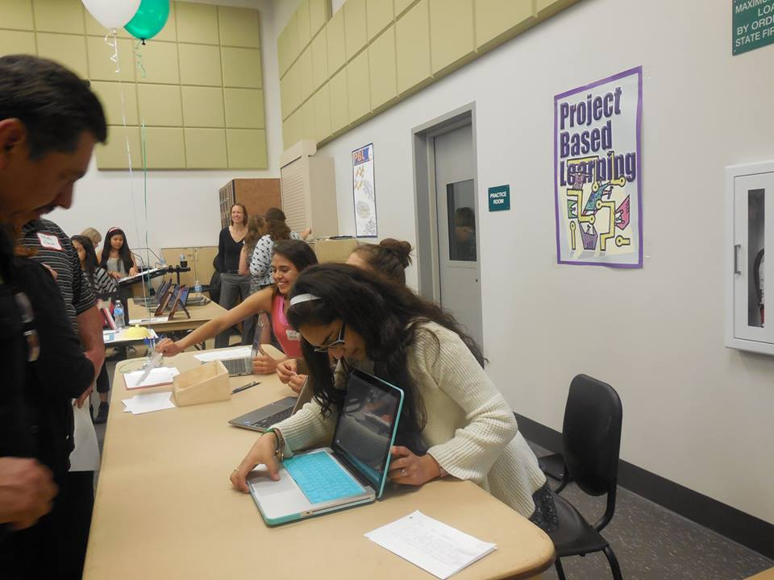
Why It Matters
School libraries are no longer just warehouses for books.
School libraries are the perfect environment for 21st century learning.

Slide 3
Goals for Calistoga’s Libraries
Create student-centered, interactive learning spaces that provide equal access to all students.
Create a teaching environment that supports 21st century learning and provides digital literacy in the implementation of CCSS and PBL.

Slide 4
Digital Literacy-What it Means
Find
Evaluate
Utilize
Share
Create
The same advances that enhance leisure and make our work easier—those that make it possible for us to search online databases, text friends, and stream media—also present urgent challenges to the social norms, market models, and legal frameworks that structure our society. (Cornell University)

Slide 5
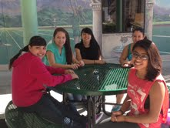
Student Needs
Digital Literacy tools
Current print resources
Databases and online encyclopedias
Presentation tools
Technology support
A hang-out (in an academic environment)
Motivation
”While students easily grasp the entertainment and communication value of the devices they use, they need to be taught how these tools can be used in learning and critical thought.”(Wikipedia)

Slide 6
Teacher Needs
Collaboration space
Innovative ideas and support from librarians
Integrative Learning experiences
Resources for CCSS and PBL with one-click access
Technology support

Slide 7
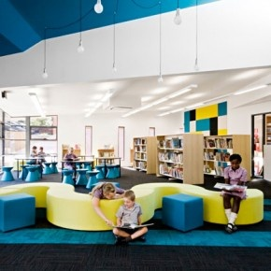
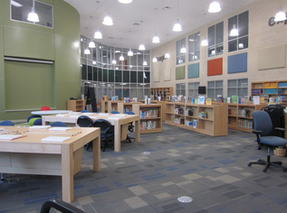
The Learning Space
Flexible
Comfortable-Lighting and Furniture
High Tech

Slide 8
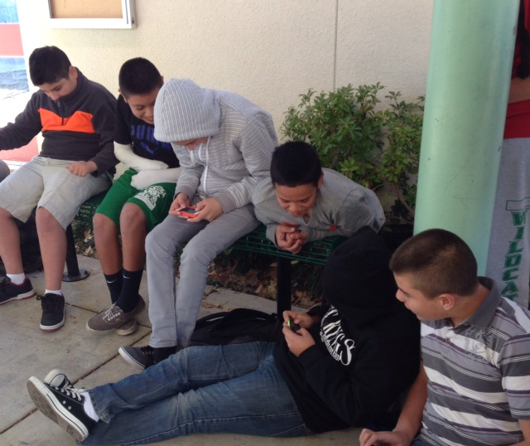
The Learning Environment
Friendly
Collaborative
Productive

Slide 9
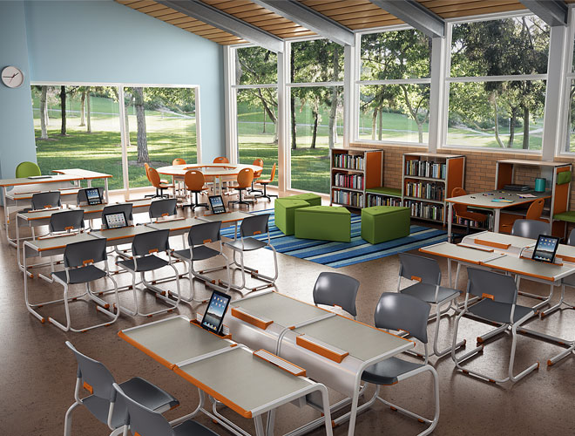
Other Uses
Integrative Learning activities
PLC meeting place
Testing area
Media viewing area
Academic tutoring
Parent meetings
Community meetings

Slide 10
Equipment Needs
Desktop workstations
Digital eReaders/iPads/iPods for student check-out
Presentation A/V equipment (SmartBoard, Screen, Audio, etc.)
Furniture – (Jr/Sr High)
Printers – Smart and 3D
Charging stations for mobile devices
Other

Slide 11
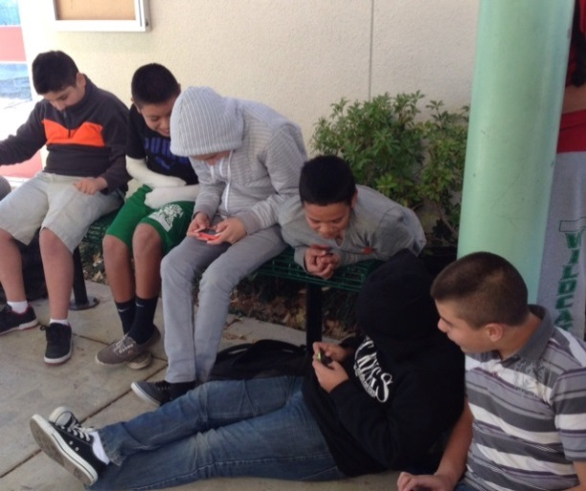
Digital & Print Needs
Ebooks/audio books through library check-out-Overdrive
Cloud-based streaming video (Discovery)
Digital textbooks
WhisperCast-Amazon school subscription?
Cloud-based subscriptions to presentation tool sites for kids
EasyBib and ResearchReady
Books- Novel ties/CCSS

Slide 12
Library Websites Can Offer…
24/7 Access
Databases
Destiny/Overdrive
Suggested Reading Lists
Teachers’ Websites and Current Projects
Research Tools
Presentation Ideas
CCSS and PBL Links
ELL Resources
Digital Citizenship Links
Example of a good elementary site

Slide 13
Things to Consider…
Learning benefits for students
Cultural or social benefits
Benefits for teachers
Equitable access for all
Community access
Ongoing costs
Custodial costs

Slide 14
Challenges
Reconfiguring space
Acquiring the technology and equipment
Cost of new equipment and space
Support staff
Needs of diverse learners
Equity in scheduling classes
Collection transition from mostly print to digital

Slide 15
Next Steps
Survey teachers –creates interest/buy-in
Survey students at junior high/high school
Library clean-up (Jr/Sr High): 2014
Organize online tools
Train teachers
Involve the community
Transition from collection management to providing services:2014-2015

